Slide 1

TRAVEL AND TOURISM

Slide 2
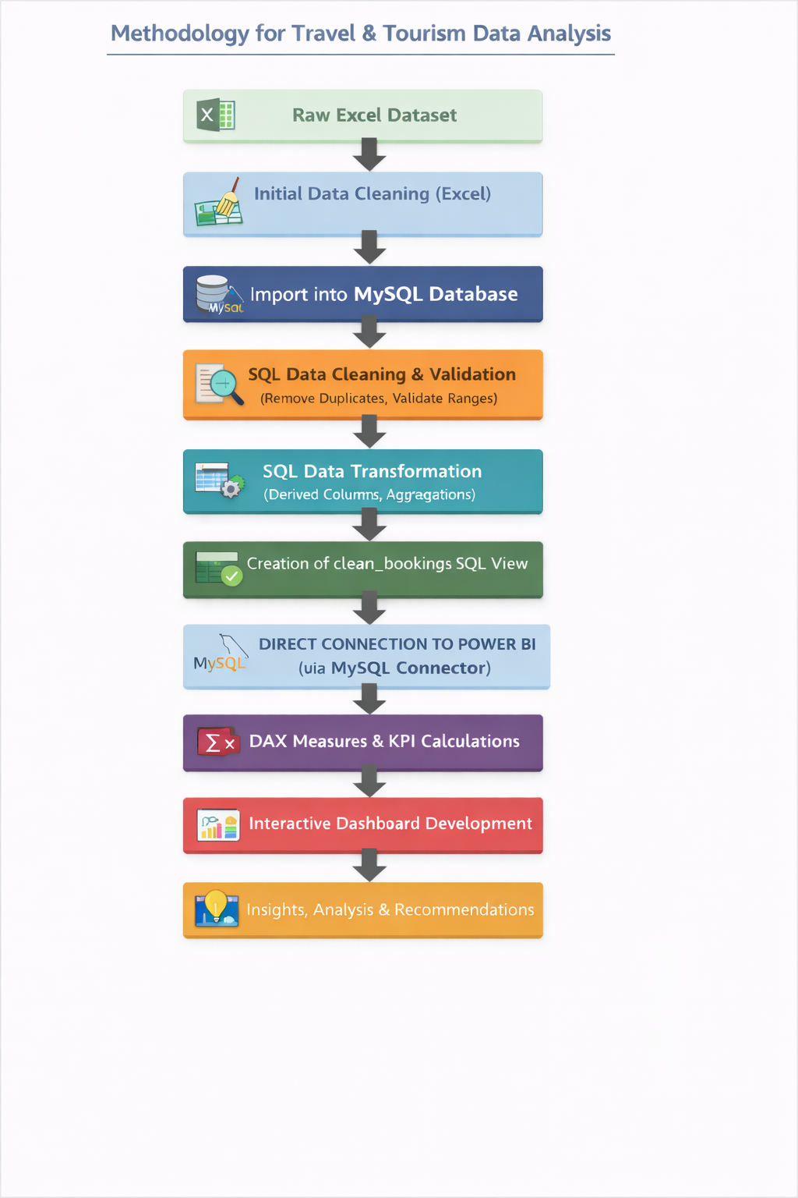

Slide 3

Project Overview
Travel & tourism industry generates large booking data
Raw data is difficult to analyze directly
This project converts raw booking data into insights
Objective:
To analyze booking patterns, revenue, customer behavior, and destination trends.

Slide 4
Dataset Description
Source: Mockaroo
Customer demographics : age, gender, country.
Travel details : destination, travel type, season, trip duration.
Booking attributes : booking channel, payment mode, booking date.
Revenue-related information : total revenue, number of travellers.

Slide 5
Tools & Technologies
Excel - Data cleaning and pre-processing
MySQL - Database storage and query-based analysis
Power BI - Interactive dashboards and visualization

Slide 6
Excel – Data Cleaning
Tasks done in Excel:
Removed duplicates
Handled missing values
Standardized date format
Capitalized first letter of Customer Name
Outcome:
Clean, structured dataset ready for database import, with properly formatted customer names.

Slide 7
Excel – Data Cleaning
Ready for SQL import

Slide 8
SQL – Database Creation & Verification
Tasks Completed:Handled missing values
Created Database: travel_tourism
Created Table: bookings with all booking and customer fields
Imported Cleaned Excel Data into MySQL
Verified Data: Checked first few rows for accuracy

Slide 9
SQL – Derived Column & Analysis
Purpose: To prepare analysis-ready data and calculate revenue per traveler for deeper insights.
ALTER TABLE bookings
ADD revenue_per_traveler DECIMAL(12,4);
UPDATE bookings
SET revenue_per_traveler = ROUND(total_revenue / number_of_travelers, 4)
WHERE booking_id > 0;

Slide 10
SQL – Derived Column & Analysis
Purpose: To prepare analysis-ready data and calculate revenue per traveler for deeper insights.
ALTER TABLE bookings
ADD revenue_per_traveler DECIMAL(12,4);
UPDATE bookings
SET revenue_per_traveler = ROUND(total_revenue / number_of_travelers, 4)
WHERE booking_id > 0;
Verified Derived Column ----> MySQL

Slide 11
SQL – Performance Analysis:
Total Revenue
Revenue by Destination
Season-wise Bookings
Booking Channel Performance

Slide 12
SQL – Statistical Analysis
SELECT
AVG(total_revenue) AS avg_revenue,
MAX(total_revenue) AS max_revenue,
MIN(total_revenue) AS min_revenue,
AVG(trip_duration_days) AS avg_trip_duration
FROM bookings;

Slide 13
SQL View & Power BI Connection
Purpose:
Prepare clean data for Power BI dashboards using MySQL Connector.
Steps:
Created a view clean_bookings in MySQL:
CREATE VIEW clean_bookings AS SELECT * FROM bookings;
2.Verified data with a few rows.
3.Connected Power BI to MySQL using MySQL Connector:
Open Power BI → Get Data → MySQL database
Enter server name & database → Import clean_bookings view

Slide 14
Power BI Dashboard Overview
Purpose:
Create an interactive dashboard for Travel & Tourism data.
What’s Included:
KPIs (DAX): Total Bookings, Total Revenue, Avg Revenue per Traveller, Total Travelers
Charts: Bar, Pie, Line, Map
Slicers: Year, Destination, Travel Type, Season

Slide 15
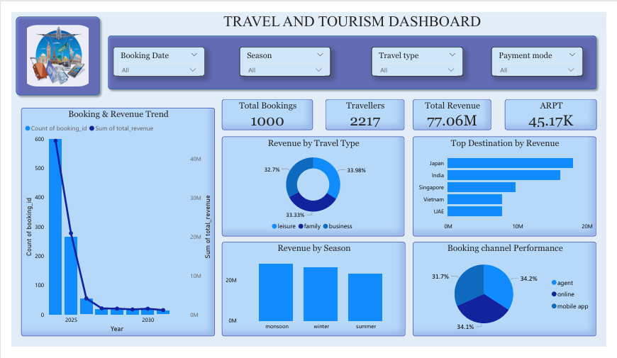

Slide 16
Insights & Analysis – Overview
Dataset Summary:
Total Bookings: 1,000
Total Travelers: 2,217 (Average 2.2 travelers per booking → strong group/family travel)
Total Revenue: 77.06M
Average Revenue per Traveler: 45.17K
Booking & Revenue Trends:
Higher booking volumes in earlier periods → sharp decline later
Revenue follows same trend → decline is demand-driven, not pricing-related

Slide 17
Insights – Travel Type & Destination
Travel Type Performance:
Leisure travel → highest revenue
Family travel → second
Business travel → lowest
Destination-wise Revenue:
Top 3 revenue-generating destinations: Japan > India > Singapore
Other destinations (Vietnam, UAE) contribute less

Slide 18
Insights – Seasonal & Booking channel
Seasonal Patterns:
Summer → highest revenue
Winter → second
Monsoon → lowest
Booking Channels:
Online platforms (App & Website) outperform offline
Indicates growing digital adoption

Slide 19
Recommendations
1.Strengthen Digital Channels
Improve app & website UX to boost conversions
2.Focus on High-Revenue Destinations
Prioritize marketing for Japan, India, Singapore
3.Address Booking Decline Trends
Seasonal campaigns, early-bird offers, promotions
4.Promote Group & Family Packages
Encourage trips with 2+ travelers
5.Improve Off-Season Performance
Special discounts, flexible policies, bundled offers for monsoon

Slide 20
Conclusion
This project presents a structured end-to-end analytics framework using Excel, MySQL, and Power BI to analyze Travel & Tourism booking data. Systematic data cleaning, SQL-based transformations, and DAX-driven KPIs enabled accurate measurement of booking patterns, revenue performance, and customer behavior.
The analysis identifies travel type, destination preference, seasonality, and booking channels as the primary drivers of demand and revenue. Overall, the project demonstrates how integrated data analytics tools can support evidence-based decision-making and strategic planning in the travel and tourism industry.

Slide 21
THANK YOU…

